Slide 1

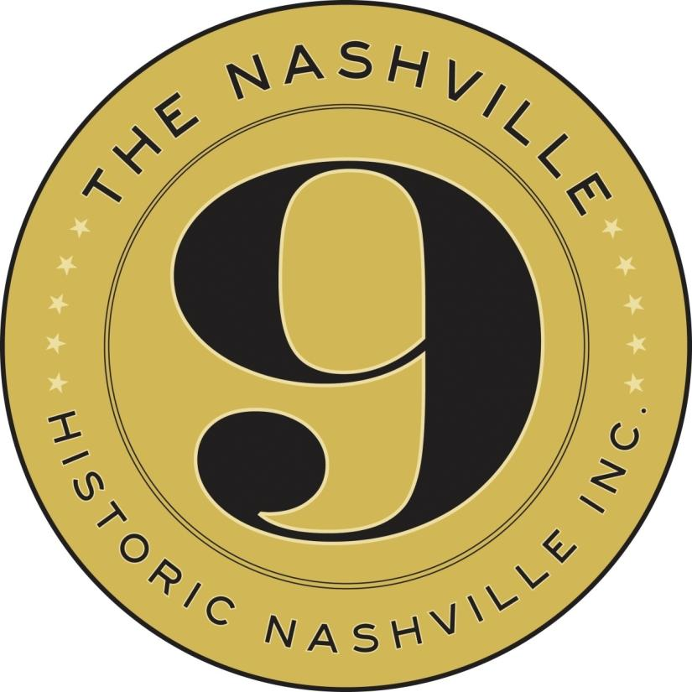
#NashvilleNine
#KeepNashvilleUnique
@Historic_Nash

Slide 2

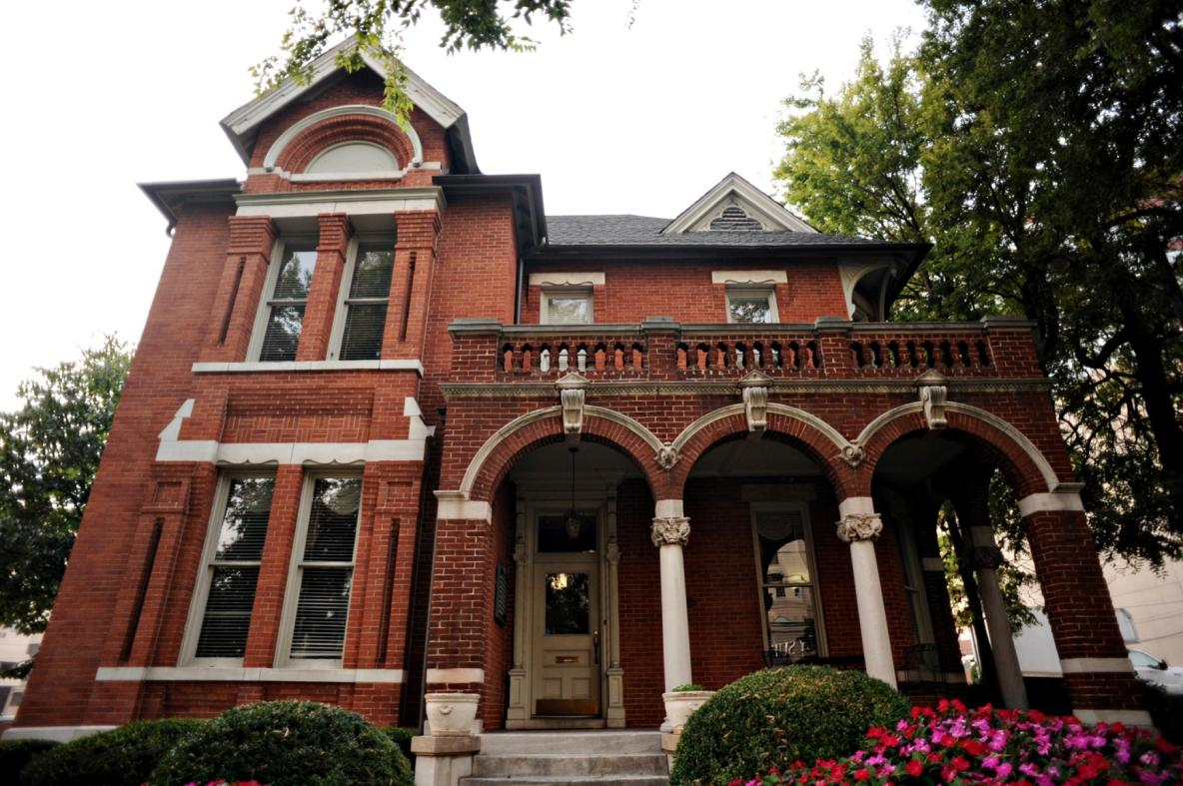

ALBERT SAMUEL WARREN HOUSE
Music Row - 1812 Broadway, built around 1888
Notes:
1812 Broadway, built around 1888
This two-story brick building is one of the few remaining grand residences located near Music Row. A native of West Tennessee, Sam Warren (1851-1922) owned a wholesale dry goods business that operated on the Public Square. In 1900, he lived in Nashville with his wife Luella (1860-1929), son, mother-in-law, two boarders and an African-American house servant. In the modern era, the well-preserved Richardsonian Romanesque-style dwelling has housed offices, including the architectural firm of Taylor & Crabtree from the 1950s through the 1980s, Atlantic Records in the 1990s and currently houses attorney’s offices. The building was restored in 1974 and nominated for a Metro Historical Commission Preservation Award the following year. Due to the immense redevelopment pressures in Midtown and Music Row, members of the community have expressed concern that this house may be demolished for condos or a high-rise hotel.

Slide 3
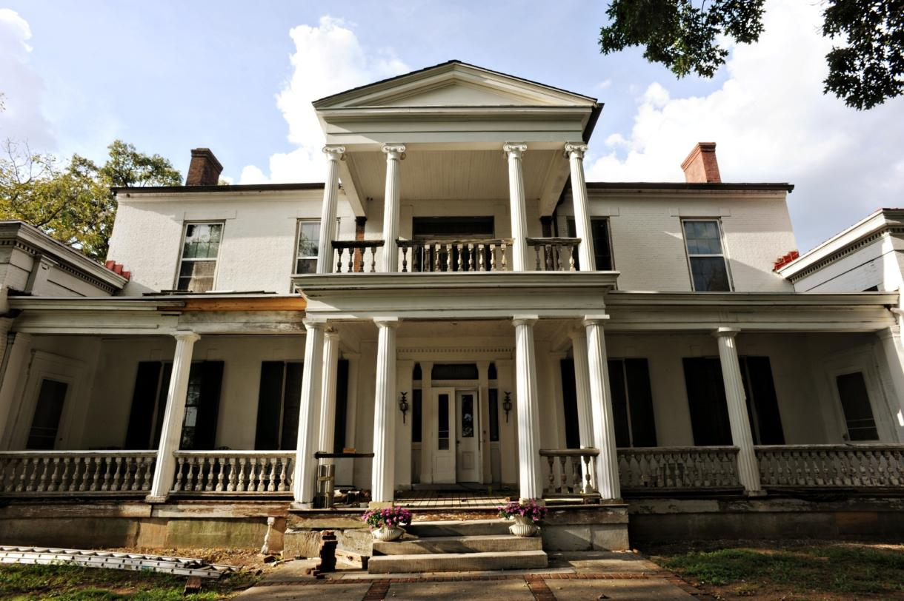
BELAIR MANSION
Donelson - 2250 Lebanon Road, constructed from 1832-1838
Notes:
Located at the Lebanon Road and Briley Parkway interchange in Donelson, this is one of the city’s few remaining examples of a Greek Revival-style antebellum mansion. The large 30-room brick home was modeled after Andrew Jackson’s Hermitage located a few miles down Lebanon Pike. Originally known as “Belle Air,” the home was built for John Harding of Belle Meade for his daughter Elizabeth V. Harding (1812-1836) who married Joseph W. Clay of Nashville. After Elizabeth’s death in 1836, the unfinished house was purchased by William Nichol (1800-1878) and his wife Julia Margaret Lytle (1808-1890); they added the wings. Nichol was a merchant and steamboat owner who served as the first president of the Bank of Tennessee and mayor of Nashville from 1835-1837. As mayor, he and business partners purchased Capitol Hill and offered it to the State of Tennessee for construction of the new state capitol. In 1850, the 1,250-acre Belair plantation was worked by 73 slaves. Belair was documented by the Historic American Building Survey in 1940 and was listed in the National Register of Historic Places in 1971. The 4.55-acre property is currently on the real estate market.

Slide 4
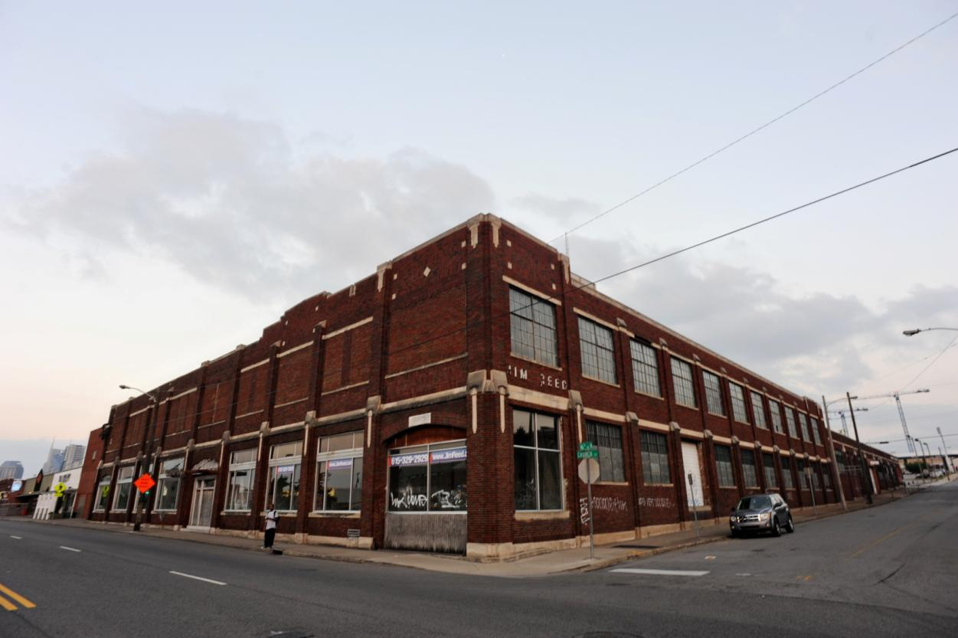
COCA COLA BOTTLING PLANT
Midtown - 1525 Church Street, built in the 1920s
Notes:
Known to many as the Old Jim Reed Showroom, this brick warehouse building was originally part of the Coca Cola Bottling Works. In the 1970s, the soft drink bottling plant was converted for use as Jim Reed’s automobile dealership. Located in Midtown, the building is an excellent example of ornate industrial architecture from the early twentieth century and perhaps Nashville’s last remaining historic soft drink bottling plant. Members of the community are worried that this unique historic landmark could be demolished for new development. In the 1990s, part of the building was converted into a nightclub.

Slide 5
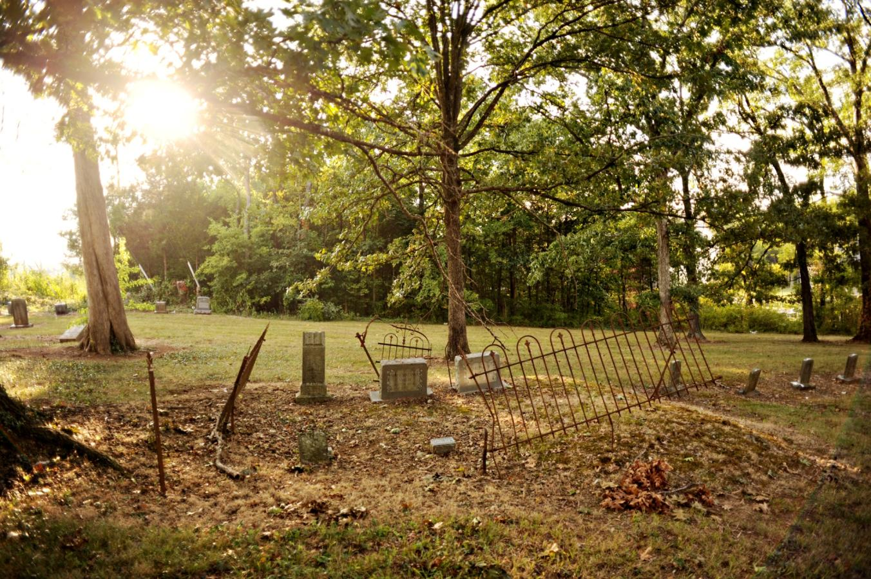
HAMILTON CHURCH CEMETERY
Antioch - 3105 Hamilton Church Road, dates from 1831
Notes:
This historic cemetery is one of several in Davidson County threatened with lack of maintenance and vandalism. Located just off Murfreesboro Road in Antioch, this cemetery dates from 1831 and contains the graves of many prominent community leaders. Several graves were located here when the Cherokee Trail of Tears passed within feet of the headstones in 1838. One headstone in particular, that of George McCullough who died in 1831, was seen by the Cherokee as they passed. At that time, the associated Methodist Church was a log building, which was burned during the Civil War. This is one of the rare historic places in Davidson County that witnessed the Cherokee Trail of Tears. In the early 2000s, the Colonial Dames and Metro Archives documented the cemetery as part of the Davidson County Cemetery Survey. Containing 95 tombstones and a dozen fieldstones, the cemetery is currently in a state of disrepair with trash and fallen trees.

Slide 6
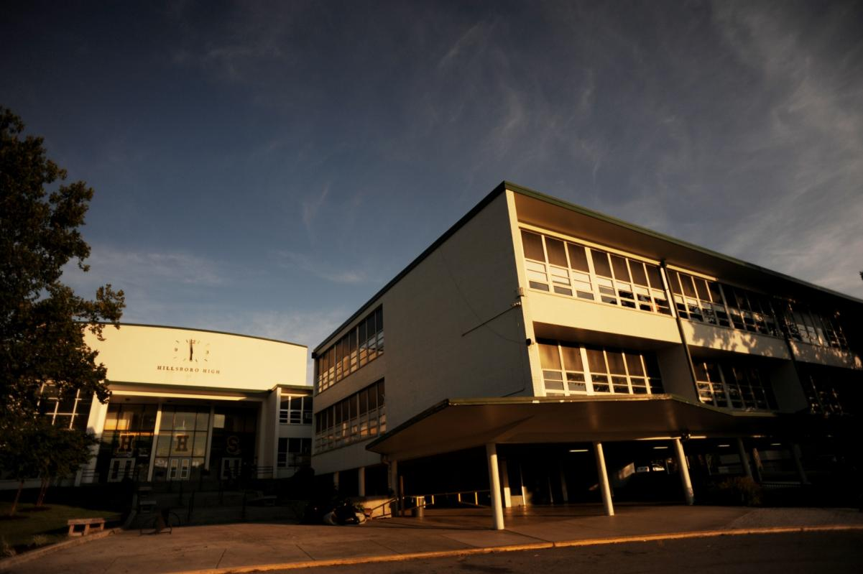
HILLSBORO HIGH SCHOOL
Green Hills - 3812 Hillsboro Pike, built 1954
Notes:
Located in the heart of Green Hills, this large public high school has served the community since 1954 after the original 1939 school was destroyed by a fire in 1952. Constructed of white brick trimmed in green, the unique school complex is an excellent example of Mid-Century Modern civic architecture in Nashville. The school was designed by Nashville architect Edwin Keeble, who is best known for designing the downtown L&C Tower. The Hillsboro campus was expanded in the 1950s and 1960s and the school underwent a renovation in 1995. A large gymnasium was constructed along Hillsboro Pike in the modern era. Notable alumni include artist Red Grooms and Major League Baseball player Mike Willis. Located across Hillsboro Pike from the upscale Green Hills Mall, the school complex is threatened with suburban retail redevelopment.

Slide 7
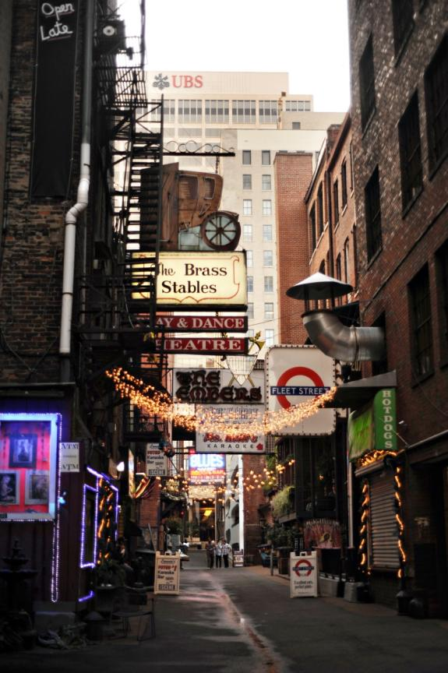
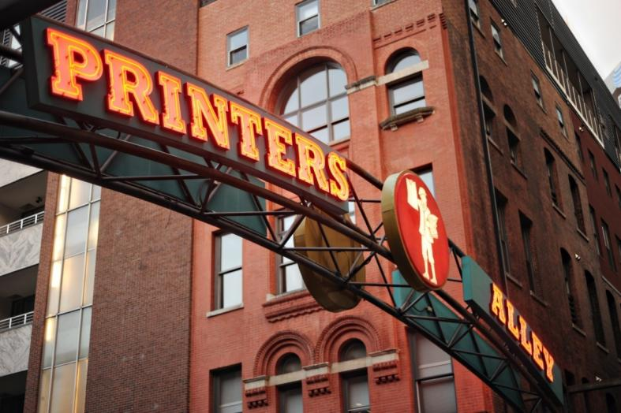
PRINTERS ALLEY HISTORIC DISTRICT
Downtown - 200 block of 3rd Ave. N & 4th Ave. N & 300 block of Church St., represents buildings built from 1874-1929
Notes:
This historic district includes 15 buildings in the heart of Nashville’s downtown commercial business district. Located adjacent to the 2nd Avenue Historic District, Printers Alley contains a variety of commercial buildings constructed from 1874-1929, ranging from one to twelve stories in height. The Printers Alley Historic District includes the 1926 Noel Place Garage, 1929 Noel Hotel, 1905 First National Bank (now Marriott Hotel), and the 1895 Southern Turf Saloon, which Historic Nashville owns a Preservation Easement on. The district also includes the 1891 Utopia Hotel, a six-story Romanesque-style hotel first included on the Nashville Nine in 2012, and the 1887 Climax Saloon – both of which will soon be redeveloped as part of a six-story luxury hotel. Since the late nineteenth century, the service alley has served as the entrance to legendary watering holes, bars, restaurants and entertainment venues. The community has expressed concerned that development in Printers Alley could have an adverse effect on the setting and integrity of this historic district, and may ultimately result in buildings being removed from the National Register of Historic Places.

Slide 8
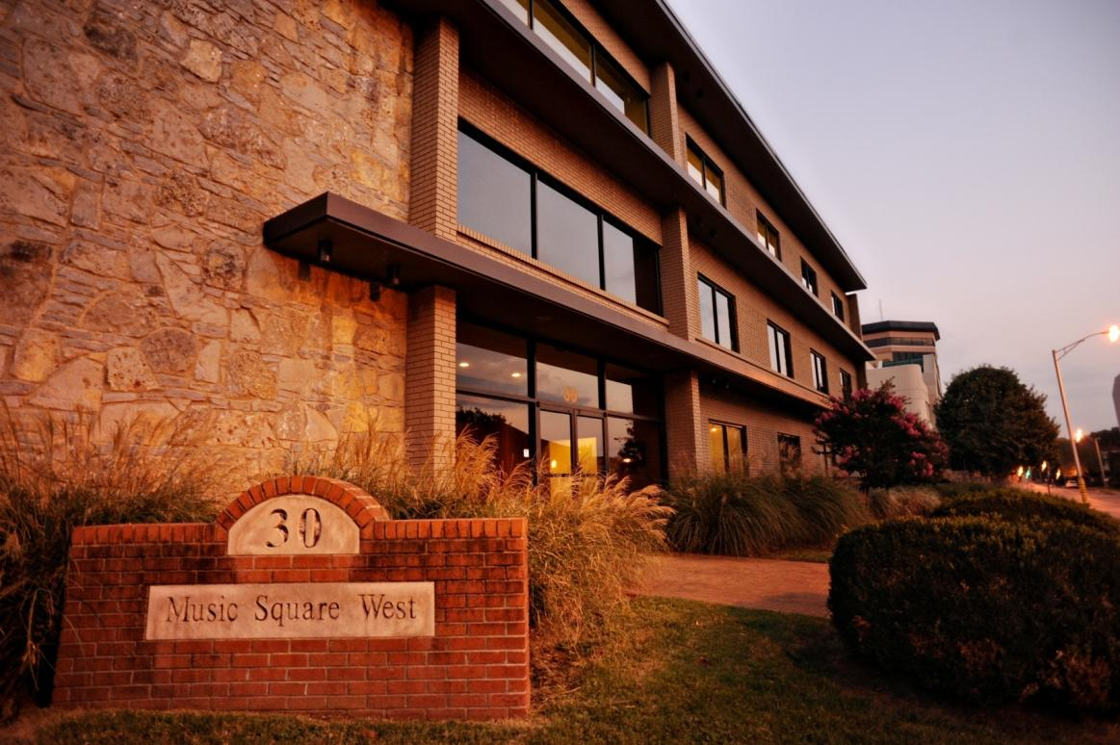
RCA STUDIO A
Music Row - 30 Music Square West, built in 1964
Notes:
Located in the heart of Music Row, this legendary recording studio was constructed by Chet Atkins and Owen Bradley adjacent to RCA Studio B, which opened in 1957. The Mid-Century Modern studio and office building became a destination for musicians from both the country and pop music industries and the building played a vital role in the development of the renowned Nashville Sound of the 1960s. In the past 50 years, countless artists of a variety of genres have recorded hits in RCA Studio A, which is the only remaining active studio of four RCA studio spaces designed by Bill Putnam, the “father of modern recording.” The building was recently sold to a developer, and a demolition permit has been filed. If executed, this building will remain standing for less than 90 days. On Sept. 19, a plan was released that showed luxury condominiums and a restaurant taking Studio A’s place on Music Row.

Slide 9
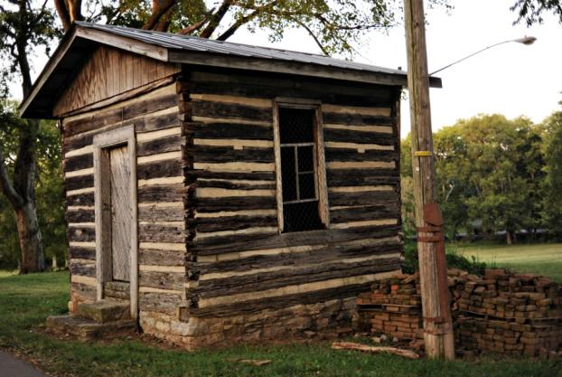
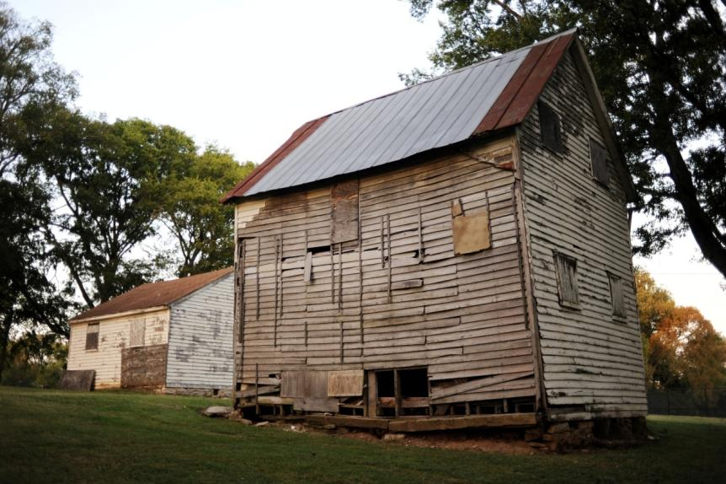
SUNNYSIDE OUTBUILDINGS
12 South - 3000 Granny White Pike, built in the early 19th century
Notes:
Located in the 12th South neighborhood, Sunnyside Mansion is the home of the Metropolitan Nashville Historical Commission and the centerpiece of Sevier Park. The mansion has been restored by the city, but the rear ell, which contains a nearly 200-year-old log cabin and several outbuildings, has not been restored and is in a state of extreme disrepair and deterioration. Metro Parks and Recreation, which is responsible for the buildings, has a master plan that – if funded – would include renovation for the outbuildings.

Slide 10
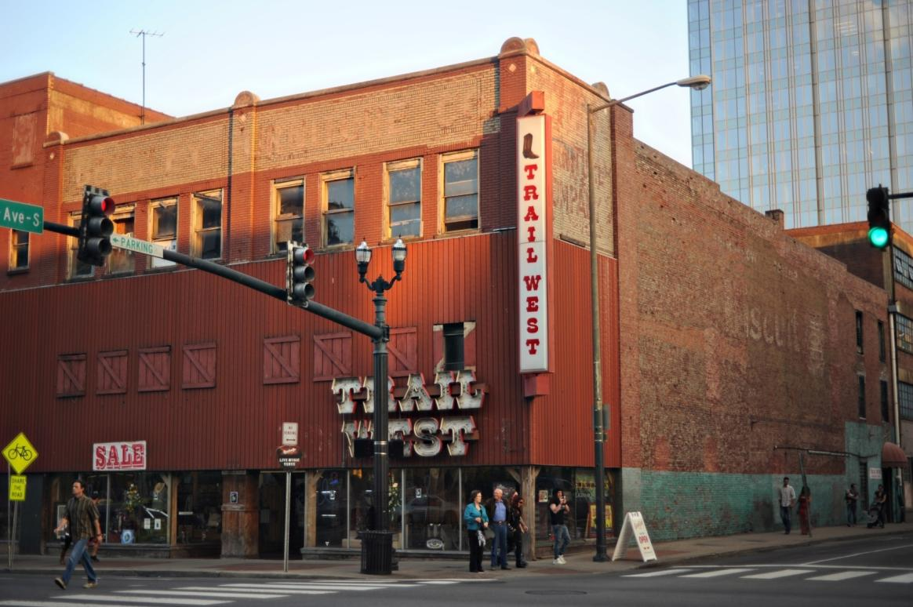
TRAIL WEST BUILDING
Downtown - 217-221 Broadway, built early 1900s
Notes:
This three-story downtown commercial building is located on historic Lower Broadway and is listed in the National Register of Historic Places as part of the Broadway Historic District. Since construction at the turn-of-the-twentieth century, this commercial building has housed various stores. Since 1997, the building has been home of the Trail West clothing shop. In recent years, the building has been proposed for several new uses including high rise luxury hotels and a Walgreens drugstore. Historic Nashville documented these buildings in the 1990s as part of its Downtown Historic Architecture Survey. Members of the community worry the historic building could be demolished or inappropriately altered as part of a new commercial development. It is also possible that demolition of these historic buildings could have a negative impact on the National Register listing of the Broadway Historic District.

Slide 11
Special Thanks
Guest Speakers: Mike Wolfe, Carolyn Brackett, Sharon Corbitt-House
Sorrell Brigman, Mike Kopp
2014 Nashville Nine Committee &
Historic Nashville Marketing Committee
Photographs by Stephanie Saujon
Logo Design by Danny Proctor

Slide 12

Thank You
Keep Nashville Unique.
www.historicnashvilleinc.org

