Slide 1
Old v/s Historic
What is historic anyway?
Melissa Wyllie

Slide 2

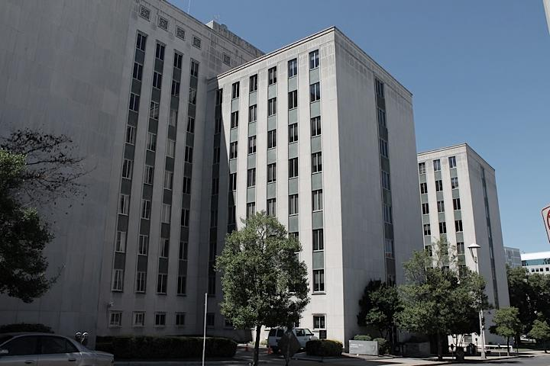
Why does it matter?
Impacts whether a property is “worth saving”
Impacts how that property may be protected
Impacts construction/renovation for a property or community
Affects the culture of a place, whether locally, regionally or nationally
“Old buildings are just old while historic buildings are worthy of preservation.”

Slide 3
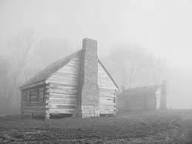
What is Historic?
To be considered historic, a property must have three essential attributes:
Sufficient age (generally at least 50 years old). That means buildings built in 1964 or earlier historic.
A relatively high degree of physical integrity
Historical significance.
That last one’s where it gets tricky …

Slide 4
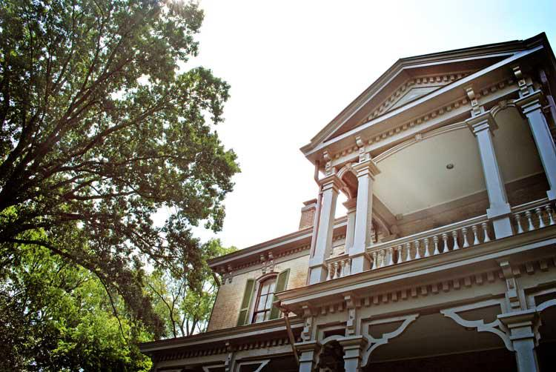
Historic Criteria #1: Age
Generally for a property to be “old enough” to be historic it must be at least 50 years old, although this is just a general rule of thumb.
The property must be old enough to have been studied by historians, architectural historians, or archaeologists so its place in history is clear.

Slide 5
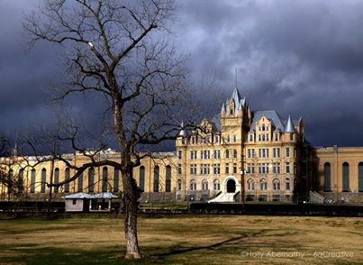
Criteria #2: Integrity
A property must retain its historic physical integrity. This means the property must be relatively unchanged.
Its essential character-defining features relative to its significance must still be present.
“In my neighborhood some folks want every old building saved even though they are infested with termites, full of asbestos and other general neglect issues.”

Slide 6
Criteria #3: Significance
A property must be considered significant to be historic.
“When most people think 'historically significant,' they may be thinking of history class-type history, rather than
architectural history.”
Association with individuals, events, activities, or developments that shaped, or reflect important aspects of our history
(2) Characteristics of an architectural style or type of building, or a method of construction. Embodying high artistic values or fine craftsmanship
(3) Potential to yield information important to our understanding of the past through archaeological, architectural, or other physical investigation and analysis.

Slide 7
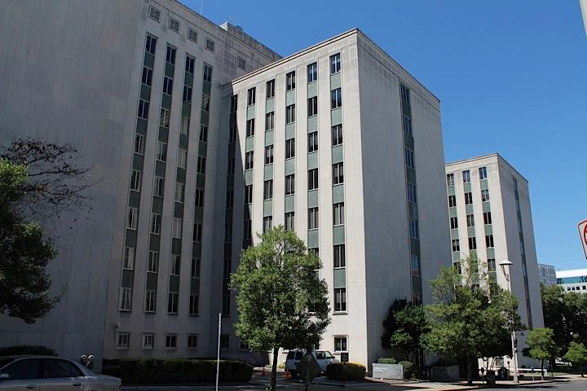
For Example:
The Cordell Hull Building
Constructed from 1952-1954
Good example of post-World War II modern design
One of the best examples of mid-century modern office architecture in the state
Eligible for listing in the National Register of Historic Places
Named after a significant American Statesman, Tennessean Cordell Hull, the longest serving secretary of state

Slide 8
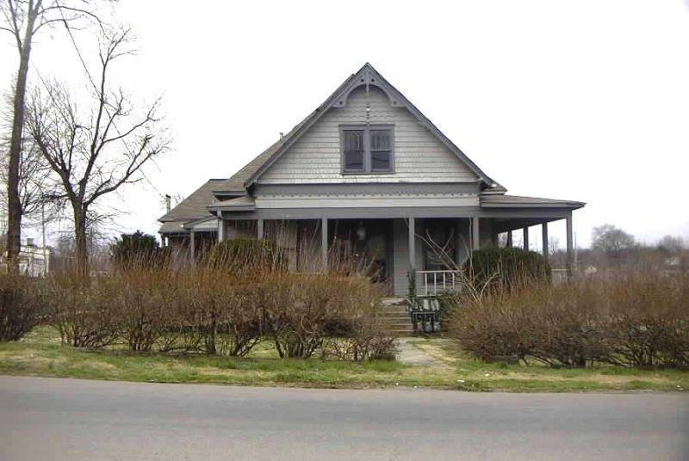
For Example:
East Nashville “Free” House
c.1885 Queen Anne-style house
Sits on Eastland Avenue in East Nashville
Originally the Spout Spring School
In the 1970s, it was converted into 3 apartments.
The house is not located within a historic overlay

Slide 9
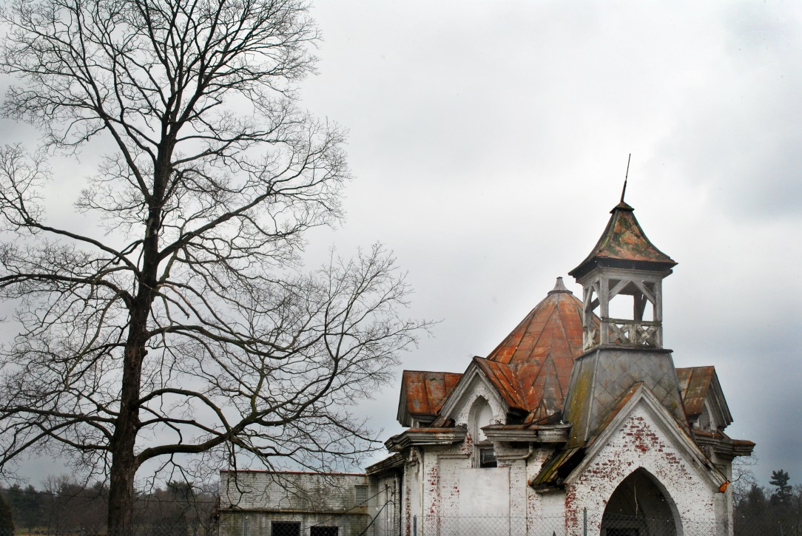
Where to Start?
Gather information about the property – description and documents
Put the place in the context of history – what can it tell us of a time in the past? An architectural style? The beliefs of a group of people? How well does it retain its character/architectural style
The National Register of Historic Places "Criteria for Evaluation" or the designation standards found in a local historic preservation ordinance are commonly used to measure the significance of a historic property.
Ten ways to look up your house’s history.

Slide 10
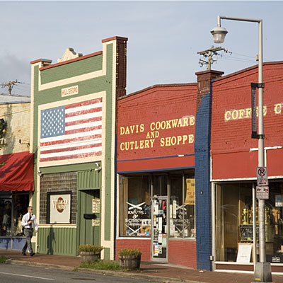
Nashville’s Historic Neighborhoods
In Davidson County, there are over 4065 buildings or structures listed in the National Register individually or as a part of a National Register Historic District.
Nashville's neighborhoods listed in the National Register of Historic Places are: Belle Meade Links Triangle, Belmont-Hillsboro, Buena Vista, East Nashville (including portions of Lockeland Springs and East End), Edgefield, Germantown, Hillsboro-West End, Old Hickory Village, Richland-West End, Waverly Place, Whites Creek and Woodland in Waverly.

Slide 11
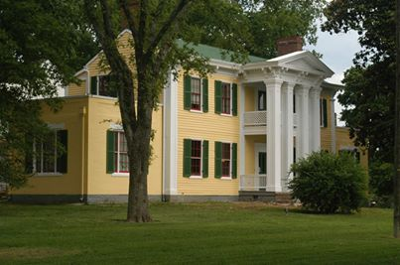
Nashville’s Historic Neighborhoods
* Historic Preservation Zoning Overlay or a Neighborhood Conservation Zoning Overlay
Belle Meade Links Triangle
Belmont-Hillsboro
Blakemore
Broadway
Cherokee Park
Eastwood
Edgefield
Elmington Place
Germantown
Greenwood
Hillsboro-West End
Lockeland Springs-East End
Maxwell Heights
Park and Elkins
Richland-West End
See if your house is in an overlay

Slide 12
For Additional Information:
Historic Nashville, Inc.
www.historicnashvilleinc.org
Metropolitan Nashville Historical Commission
www.nashville.gov/Historical-Commission.aspx
Tennessee Historical Commission
www.tn.gov/environment/history/
National Preservation Trust
www.preservationnation.org
Secretary of the Interior’s Treatment of Historic Properties Standards
www.nps.gov/tps/standards.htm

Slide 13
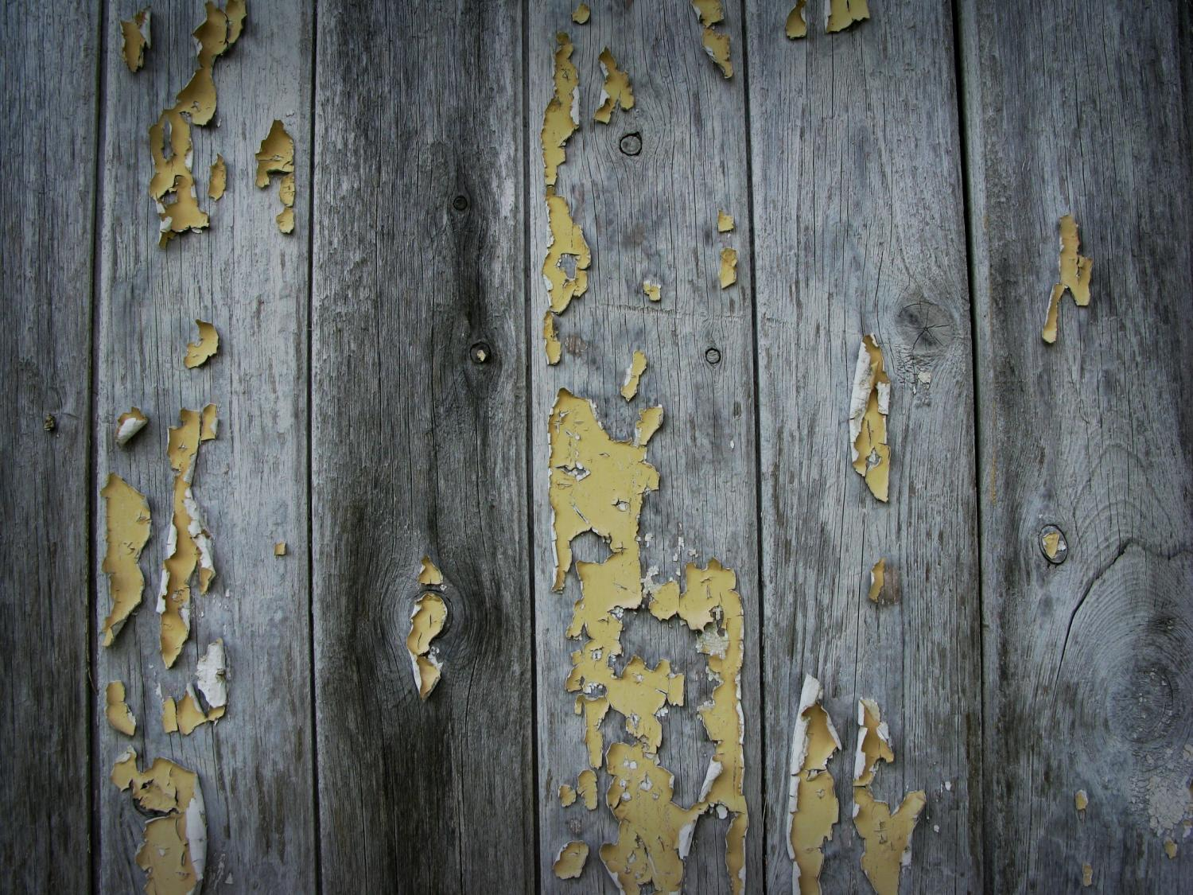

Thank You
Keep Nashville Unique.
www.historicnashvilleinc.org

